Slide 1

PP 297 – Stata for Policy Analysts
Welcome!
250 is a large space, please fill the 2nd and 3rd rows, first!
Notes:
12:00

Slide 2
Welcome Back Ice Breaker!
Notes:
12:10

Slide 3
Today’s Roadmap
Introductions
Course logistics
Outline of course material
First look at Stata
Why take this course?
Questions
Notes:
12:15

Slide 4
Introductions
Instructor: Aaron Scherf, MDP Candidate 2020
Email: aaron_scherf@berkeley.edu
Office hours: 9am – 10am in GSPP Computer Lab
Preferred Pronouns: He, him / They, them
Research Areas:
Affordable housing and urban land use
Microfinance and financial access
Integration of asylum seekers and asylum policy
Applied data science methods and transparent research
Introductions
Course Logistics
Notes:
12:17

Slide 5
A little bit about myself…
Notes:
12:18

Slide 6
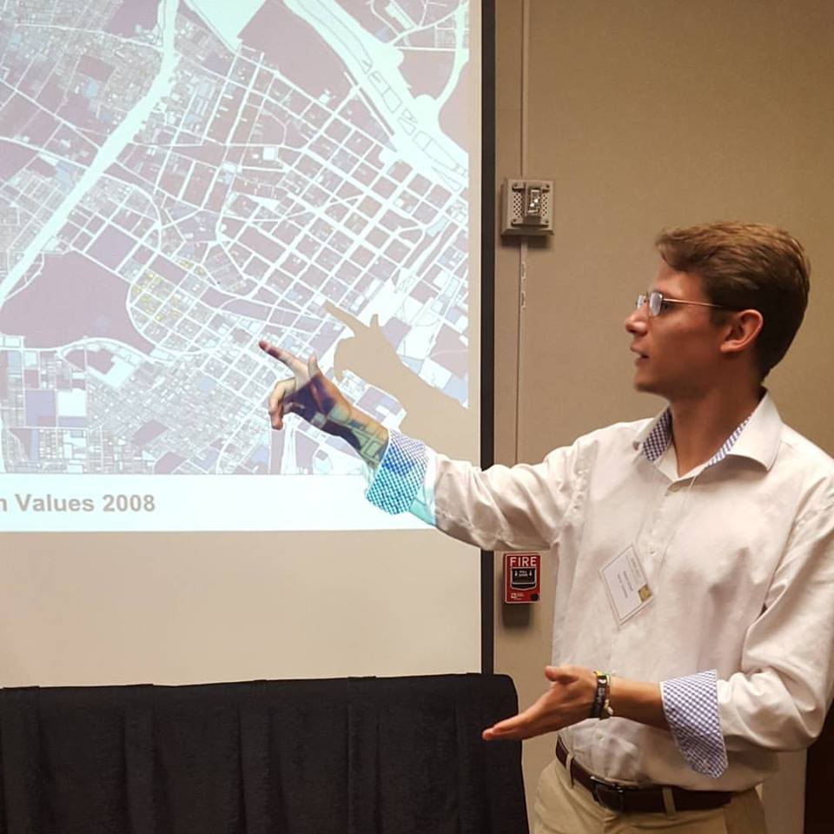


Slide 7



Slide 8



Slide 9


Slide 10
Course Logistics
Notes:
12:20

Slide 11
Course Workload
Weekly class from 12:10-1:30
Six problem sets
One data analysis project
Course Logistics
Course Material
Notes:
12:20

Slide 12
Grades
Attendance/Participation …………… 36%
3 points per class (3 “free” absences)
Problem Sets ……………………………… 36%
6 points each
Data Analysis Project …………………. 28%
More info as we progress through the semester
Course Logistics
Course Material
Notes:
12:22

Slide 13
Correspondence
Feel free to email me with issues both content related and logistic.
If you would like a content related question answered via email please include a sample do-file and dataset of the work you have attempted so far.
Course Logistics
Course Material
Notes:
12:22

Slide 14
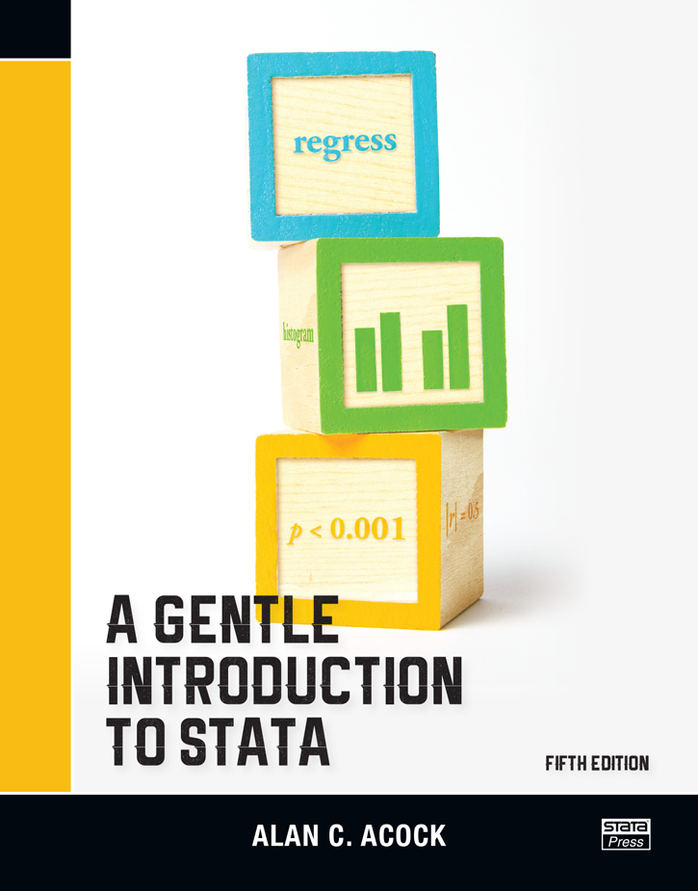
Textbooks/Resources
No class text!
Good resource: A Gentle Introduction to Stata
Consult the syllabus for other resources
Course Logistics
Course Material
Notes:
12:24

Slide 15

Technology Requirements
are not required
Laptops...
A personal copy of Stata…
is not required
Course Logistics
Course Material
Notes:
12:25
Computer lab is available
However, if you have a laptop, bring it!
Share with your neighbor

Slide 16
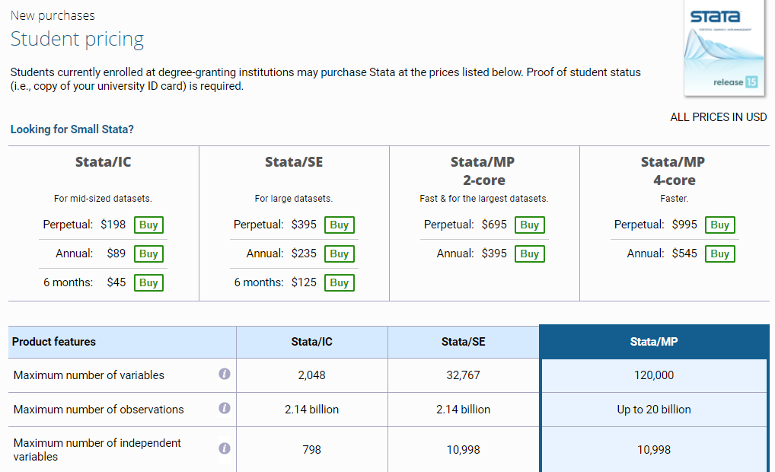
Purchasing Stata
https://www.stata.com/order/new/edu/gradplans/student-pricing/
Course Logistics
Course Material
Notes:
12:25

Slide 17
Outline of course material
Stata
Descriptive statistics
Statistical tests
Data management
Regression analysis
Data visualization
Causal inference
Tableau
Data visualization
Mapping
QGIS
Geospatial data manipulation
Mapping
GitHub
Web hosting, version control
Course Material
First Look at Stata
Notes:
12:27
The course will pace with Quant

Slide 18
First Look at Stata
Notes:
12:30

Slide 19
What is Stata?
Statistical software package. Used in research in the fields of economics, political science, sociology, epidemiology.
Used for data managing, statistical analysis, graphics, simulations, regression, programming.
First Look at Stata
Why Take this Course?
Notes:
12:30

Slide 20
It’s pronounced Stay-ta, not Stah-ta
(but really, people disagree on the pronunciation)
Notes:
12:31

Slide 21
What is Stata?
Stata is not Excel
Programming Language vs. Point-and-Click
Helps reproducibility
Can always output into Excel
First Look at Stata
Why Take this Course?
Notes:
12:32

Slide 22
Stata Interface
Command window
Output window
Variables window
Properties window
Tools
First Look at Stata
Why Take this Course?
Notes:
12:33 – Have everyone try to open Stata and follow along

Slide 23
Stata Interface
Do-files
Executes multiple lines of code
Reproducibility
Easy to edit
First Look at Stata
Why Take this Course?
Notes:
12:37

Slide 24
Stata Help Commands
Title
Syntax
Menu
Description
Options
Examples
Video Example
Stored Results
Getting your money’s worth from Stata Corp
First Look at Stata
Why Take this Course?
Notes:
12:40

Slide 25
Entering Data
Directory Commands: Modify the folder in which you are working
pwd or cd shows the current directory
dir shows the files contained in that directory
cd changes the directory
For Mac users:
. cd “/Users/Aaron/Documents/”
For PC users:
. cd “C:\Users\Aaron\Documents\”
First Look at Stata
Why Take this Course?
Notes:
12:43

Slide 26

Stata Tip
Stata is case sensitive.
Best practice: do not use upper case letters unless the upper case content is in quotes (e.g., a folder directory)
Ex.: “cd” is not equivalent to “CD”
Notes:
12:46

Slide 27
Entering Data
Now we need data…
If there is previous information in Stata, we must clear the entire dataset
clear wipes clean your command window and any existing dataset
If the new dataset is in our current directory (same folder), we type:
use [datasetname] Ex.: use ____________
If not, we must type the name and location:
use “C:\Users\James\Documents\”
sysuse uses the databases in the system directory
sysuse [datasetname] Ex.: sysuse auto
First Look at Stata
Why Take this Course?
Notes:
12:46

Slide 28
Entering Data
import excel “file path”, for xls and xlsx files
import delimited “file path”, for csv files
import options include:
clear replaces existing data
delimiters(“,”) for csv files
firstrow treats the first row as variable names
You can also use the “File -> Import” tab, which produces a command
Exporting data as Excel friendly files works the same way
First Look at Stata
Why Take this Course?
Notes:
12:50

Slide 29
Entering Data
describe describes the data; can be used for the whole dataset or for individual variables
Ex.: des make price mpg
describe shows the following information:
Variable name
Storage Type: How is data stored? Two basic types: string, which are text variables, and numeric variables.
Display Format: How is data displayed in tables
Value label: Store numerical data while displaying text.
Variable label: The name of the variable when communicating with other people. Stata uses this label when making tables.
First Look at Stata
Why Take this Course?
Notes:
12:52

Slide 30
Descriptive Statistics
Now that we have some data…
summarize yields summary statistics (observations, mean, std.. dev., min and max); can be used for the whole dataset or for individual variables
sum [variable] Ex.: sum price
We can also use command options such as detail, which yields even more information. To use options we put a comma [,] and the option that we want
sum [variable], detail Ex.: sum price, detail
First Look at Stata
Why Take this Course?
Notes:
12:55

Slide 31
Descriptive Statistics
tabulate yields a table with frequency/percentage. Requires variable name. Can produce one-way / two-way tables:
tab [variable] Ex.: tab mpg
We can also use options to gain more information:
Ex.: tab foreign, summarize (mpg)
We can also create two-way tables to display either frequency or percentages, as well as calculate row or column sums
Ex.: tab mpg foreign
Ex.: tab mpg foreign, row
Ex.: tab mpg foreign, column
First Look at Stata
Why Take this Course?
Notes:
1:00

Slide 32
Descriptive Statistics
tabstat yields tables with various summary statistics.
tabstat [variable] , statistics(stats)
Ex.: tabstat mpg, statistics(mean)
We can also use options to quickly group by variables:
tabstat [variable] , by(variable) s(stats)
Ex.: tabstat mpg, by(weight) s(mean, p50, var, sd)
First Look at Stata
Why Take this Course?
Notes:
1:08

Slide 33
A note on slide syntax…
Color scheme
Commands will be in BLUE
Variables in RED
Details in LIGHT BLUE
Anything else in PURPLE (for now)
Abbreviations
Stata commands have short-hand
Underlined on slides
First Look at Stata
Why Take this Course?
Notes:
1:12

Slide 34
Why take this course?
Notes:
1:14

Slide 35




Stata vs other programs
Pros and cons
Primarily: Ease of use vs flexibility
Why take this course?
Questions
Notes:
1:15
I know there’s some big enthusiasm about R and other stats programs, particularly amongst the first years

Slide 36
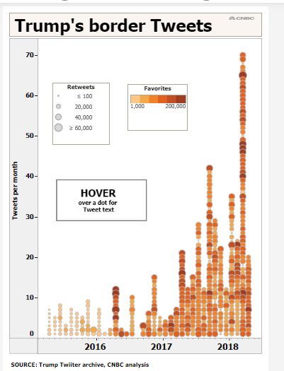
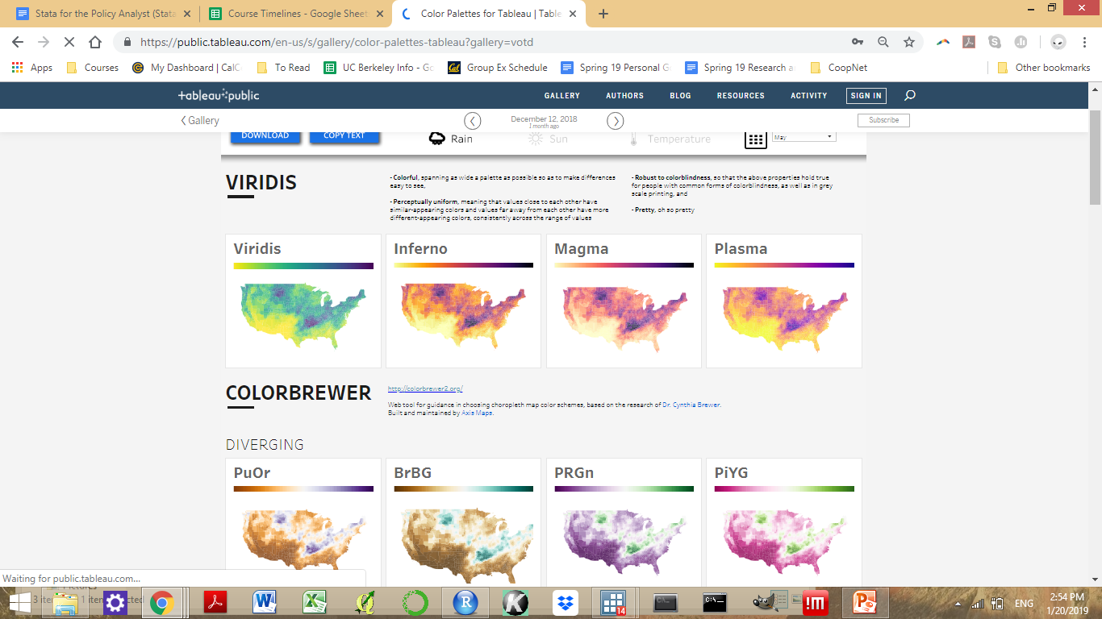
Notes:
1:17

Slide 37
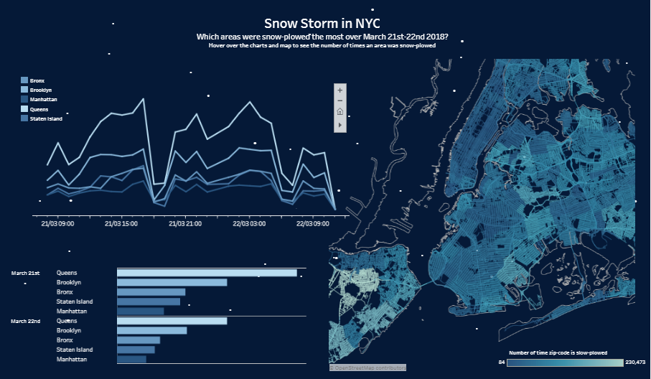
Notes:
1:20

Slide 38

Quant assignments
Why take this course?
Questions
Notes:
1:22
Invest the time up front!

Slide 39
Auditing?
Email me: aaron_scherf@berkeley.edu
Notes:
1:23
If I still haven’t convinced you to take the course for credit, then yes, auditing is an option
I will add you to bCourses!

Slide 40
Questions?
Notes:
1:25

Slide 41
Next Seminar: Data Management 1 1/30/19
Notes:
1:28

Slide 42
Notes:
1:28

Slide 43
Name
Email
Program
Auditing?
Self-Rated Stata Skill (1-5)
Notes:
1:28

